Slide 1
Bacterial Diseases

Slide 2
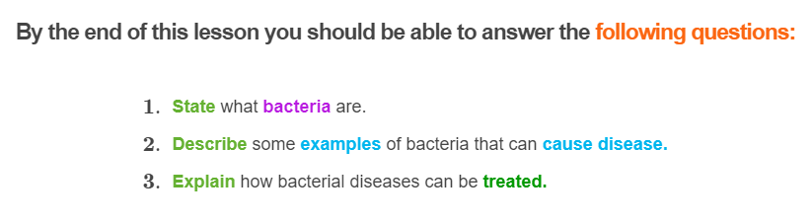
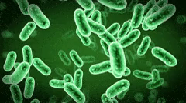

Slide 3
Microorganisms
You may have heard of the term 'germ' used for bugs. Germs are all around us! Some have the potential to cause disease, while others do not.
In biology, we use the word 'microorganism' (microbe) to describe these bugs. Microorganisms are organisms so tiny that they can only be seen with a microscope.
A 'pathogen' is the scientific word for a microorganism that has the potential to cause disease.

Slide 4
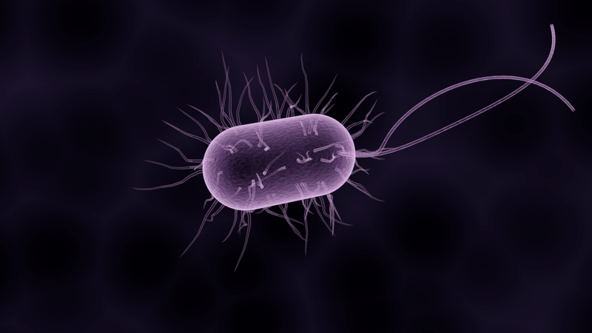
Some examples of pathogens include viruses, bacteria, fungi and parasites.
Although we come into contact with pathogens everyday, most of the time our body's immune system destroys them before they can cause any harm.
In this lesson we will be looking at bacteria. We will look at the other types of pathogens in the next few Smart Lessons.

Slide 5
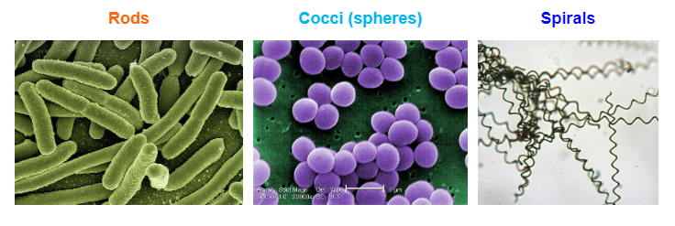
Bacteria
Bacteria are single cell organisms (this means that it only consists of one cell!) Bacteria do not have a nucleus. Instead their genetic material floats around in the cytoplasm.
Bacteria also come in many different shapes including rods, cocci (spherical shaped) and spirals.

Slide 6

Bacteria can be found in soil, water, on your dog's nose, inside you, on you, they are everywhere!
Not all bacteria will cause disease. Some bacteria have a beneficial role in our lives, like the bacteria that live in your gut which help you to break down food. These are called non-pathogenic bacteria.
There are also harmful bacteria which can cause serious disease in humans. These are called pathogenic bacteria.

Slide 7
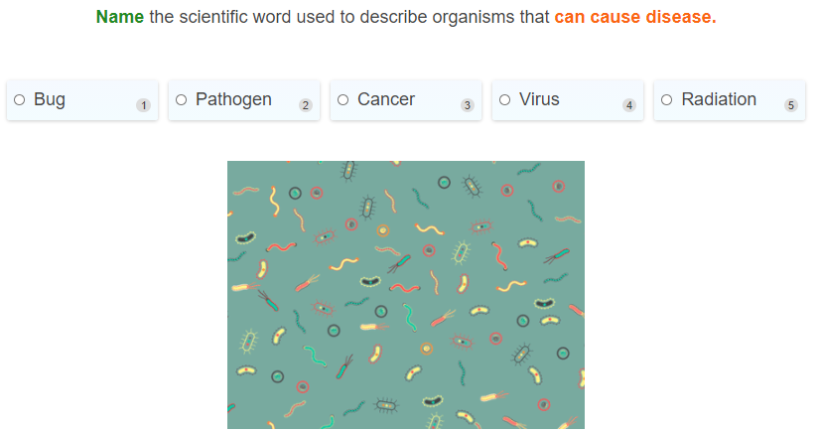

Slide 8
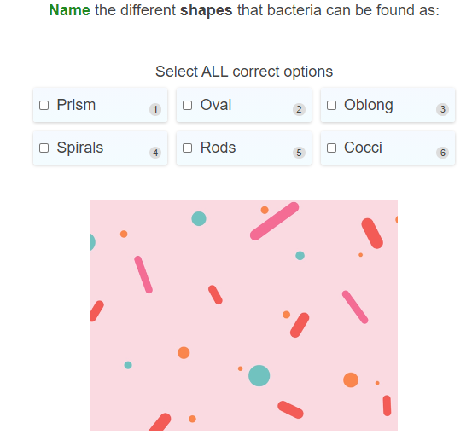

Slide 9
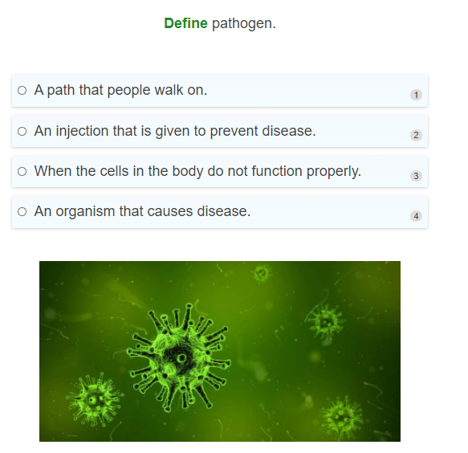

Slide 10
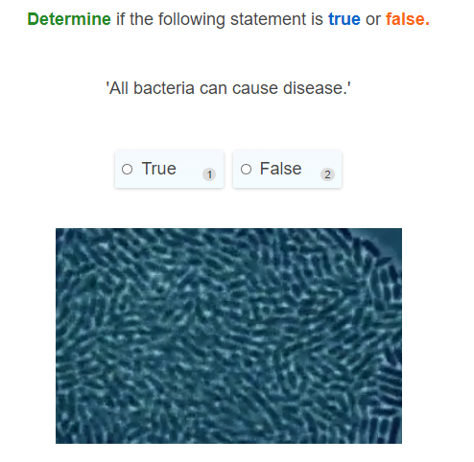

Slide 11
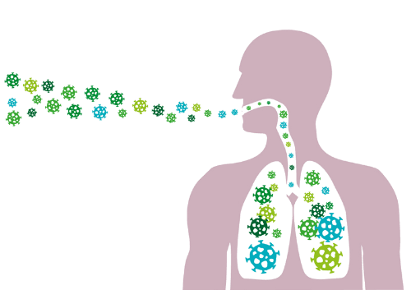
Let's take a look at how pathogenic bacteria can make us sick!
1. The first step in infection is the bacteria entering into the body. This can occur in many different ways, such as through the mouth (inhaling droplets that contain bacteria, or drinking or eating food that contains pathogenic bacteria).
Bacteria could also enter through cuts in the skin if you have accidentally cut yourself.

Slide 12

2. Infection occurs when the bacteria that has entered the body begins to multiply - this is called an infection. A lot of the time, the pathogen can be destroyed by the body's defence system - the immune system.

Slide 13
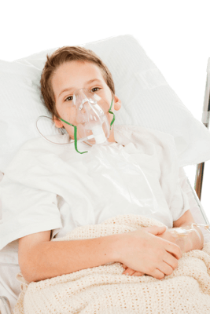
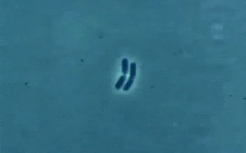
3. However, sometimes the bacteria can escape the immune system. This means that the pathogen is not destroyed which allows it to continue to grow and spread to other parts of the body.
The pathogen can cause disease by destroying the cells of the body, which results in impairment of body functions.

Slide 14
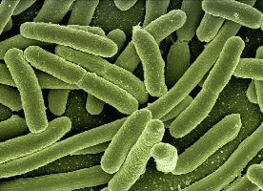

An example of a pathogenic bacteria is Salmonella!
This bacteria is often found in raw meat (usually chicken), and also in eggs. It can cause food poisoning in people who eat contaminated food products that have not been cooked properly.

Slide 15
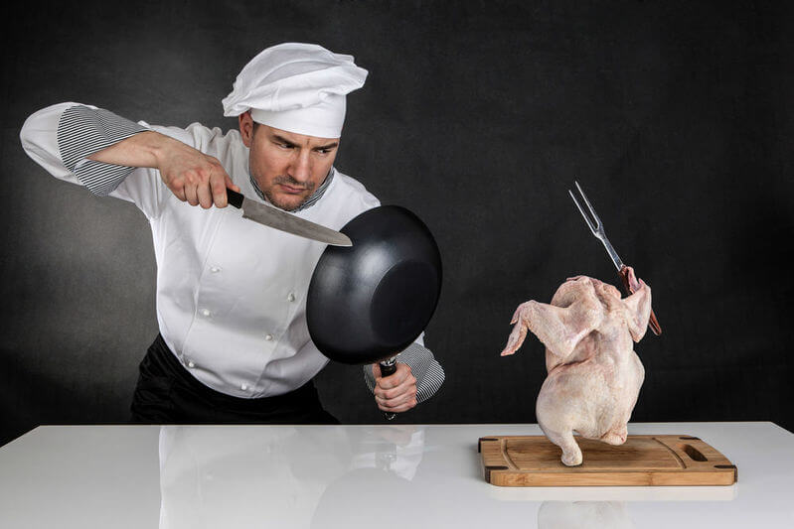
Salmonella food poisoning
You can avoid getting infected by this pathogen as long as you cook raw chicken and egg products properly, as the heating process during cooking will kill the bacteria.
Washing hands after touching raw meat products will also help prevent the spread of the bacteria.
Symptoms of food poisoning are usually diarrhoea, stomach pain, vomiting and/or fever. In severe cases, food poisoning can even be life threatening!

Slide 16
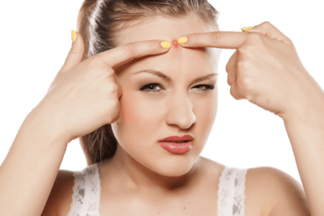
Staphylococcus bacteria
Ever had a nasty pimple? You can blame bacteria for this! Staphylococcus bacteria, or “Staph” for short, are a common type of bacteria that lives on the surface of the skin and, under the right conditions, can contribute to pimples.

Slide 17
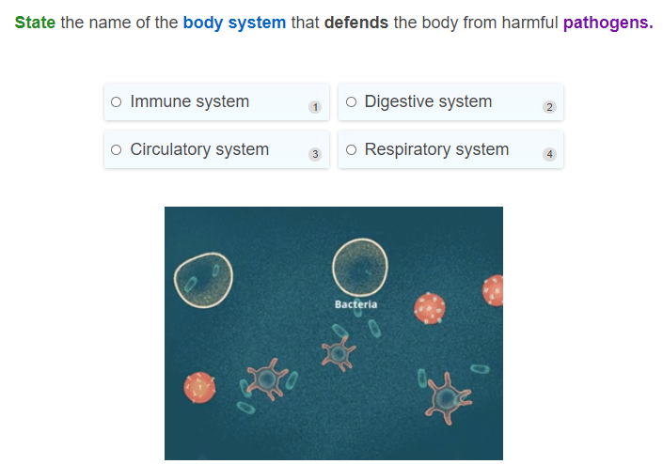

Slide 18
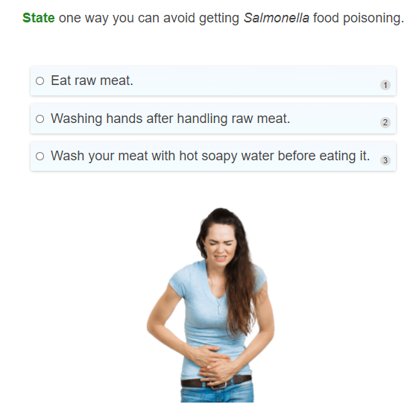

Slide 19
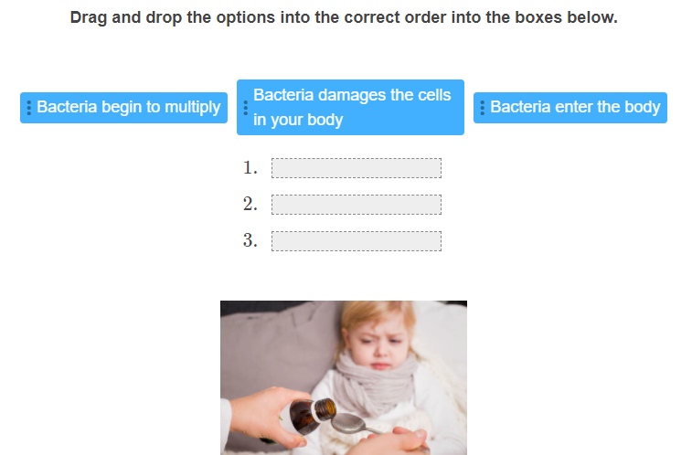

Slide 20
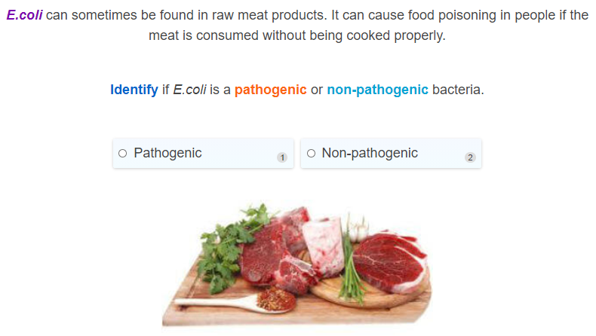

Slide 21
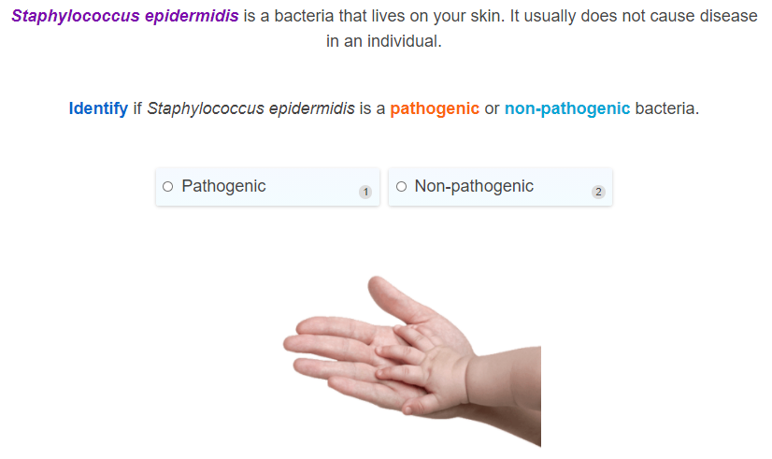

Slide 22
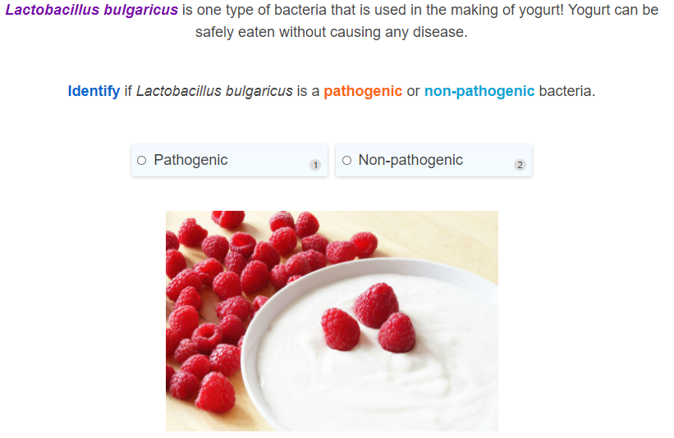

Slide 23

Antibiotics
Let's look at antibiotics, which are a way of treating some bacterial diseases once people have contracted them. They are not used to prevent disease, only treat it.

Slide 24
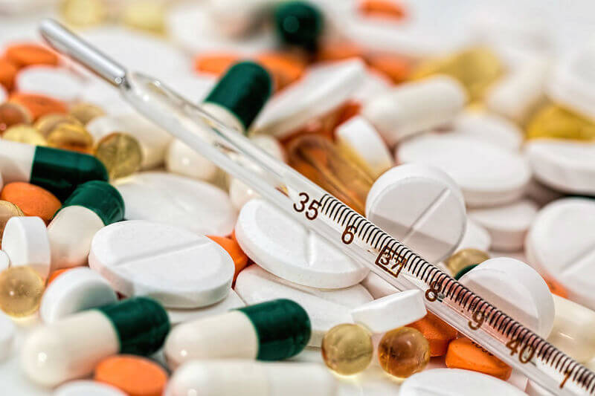
Antibiotics are a type of medicine that can kill bacteria.
This means they can be used to treat diseases caused by bacteria.
"Antibiotic" literally means "life-killing." Bacteria are alive, so antibiotics can kill them.

Slide 25
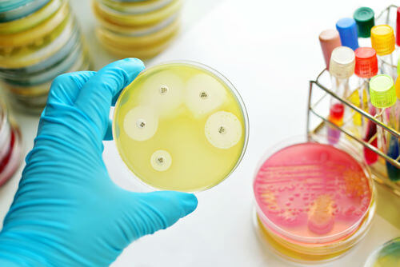
Antibiotics were first discovered in 1928 by Alexander Fleming.
He discovered them accidentally when a Petri dish he had been growing Staphylococcus aureus bacteria on became contaminated with mould.
He noticed that the bacteria around the mould had been killed, thus leading to the discovery of penicillin, the first antibiotic!

Slide 26
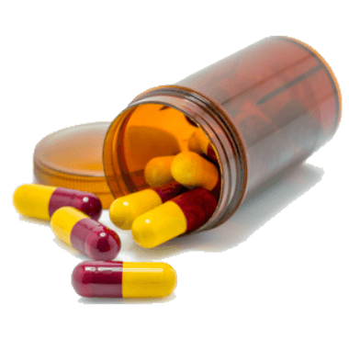
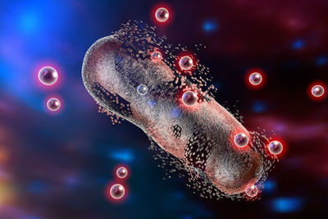
Antibiotics only target bacteria
Antibiotics work by targeting specific regions on the bacteria which will kill or slow the growth of bacterial cells, while leaving our own body cells unharmed.
These specific structures or processes are only found in bacteria and not in human cells. This means that antibiotics only target bacteria - not viruses or other pathogens.

Slide 27
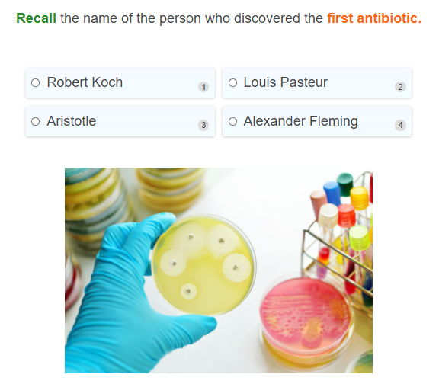

Slide 28
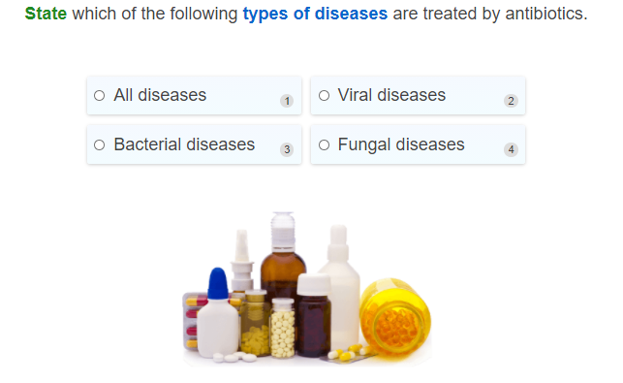

Slide 29
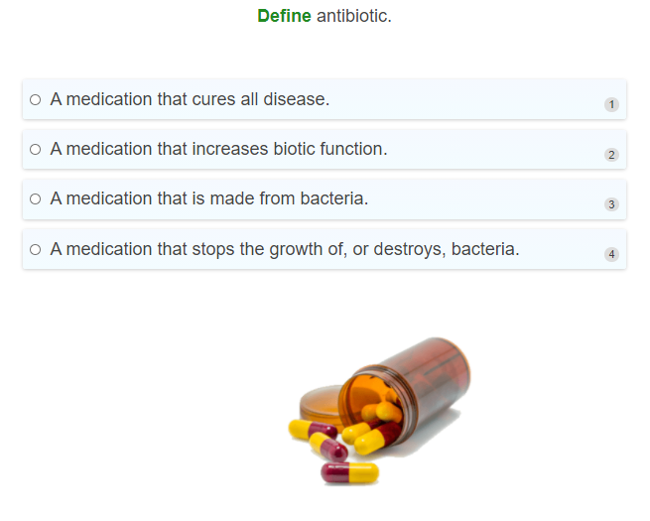

Slide 30
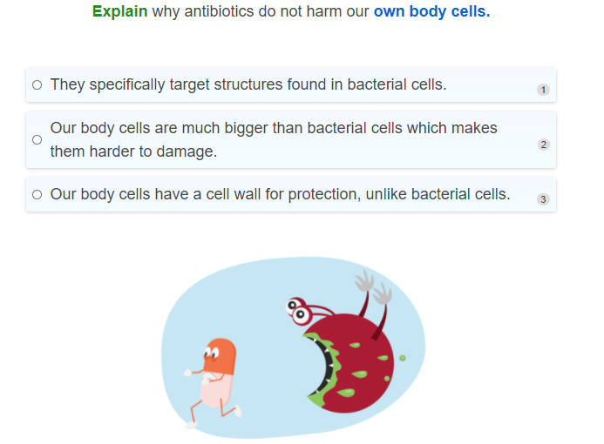

Slide 31
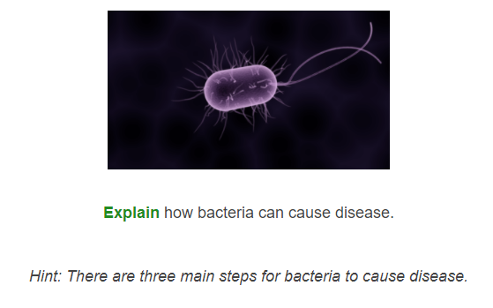

Slide 32
